Slide 1
OSPF: Exemple pratique

Slide 2
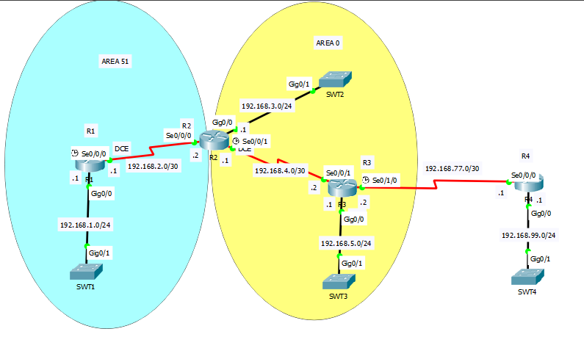
Schéma de la topologie d’étude
2

Slide 3
Configuration des routeurs
Configuration des routeurs
3

Slide 4
Configuration des routeurs
Configuration des routeurs
R1
R1(config) | interface GigabitEthernet0/0
R1(config-if) | ip address 192.168.1.1 255.255.255.0
R1(config-if) | no shutdown
R1(config-if) | exit
R1(config) | interface Serial0/0/0
R1(config-if) | ip address 192.168.2.1 255.255.255.252
R1(config-if) | clock rate 64000
R1(config-if) | no shutdown
R2
R2(config) | interface GigabitEthernet0/0
R2(config-if) | ip address 192.168.3.1 255.255.255.0
R2(config-if) | no shutdown
R2(config-if) | exit
R2(config) | interface Serial0/0/0
R2(config-if) | ip address 192.168.2.2 255.255.255.252
R2(config-if) | no shutdown
R2(config-if) | exit
R2(config) | interface Serial0/0/1
R2(config-if) | ip address 192.168.4.1 255.255.255.252
R2(config-if) | clock rate 64000
R2(config-if) | no shutdown
Voir commande : Routeur# show ip interface brief
4

Slide 5
Configuration des routeurs
Configuration des routeurs
R3
R3(config) | interface GigabitEthernet0/0
R3(config-if) | ip address 192.168.5.1 255.255.255.0
R3(config-if) | no shutdown
R3(config-if) | exit
R3(config) | interface Serial0/0/1
R3(config-if) | ip address 192.168.4.2 255.255.255.252
R3(config-if) | no shutdown
R3(config-if) | exit
R3(config) | interface Serial0/1/0
R3(config-if) | ip address 192.168.77.2 255.255.255.0
R3(config-if) | clock rate 64000
R3(config-if) | no shutdown
R3(config-if)
R4
R4(config) | interface Serial0/0/0
R4(config-if) | ip address 192.168.77.1 255.255.255.0
R4(config-if) | no shutdown
R4(config-if) | exit
R4(config) | interface gigabitethernet 0/0
R4(config-if) | ip address 192.168.99.1 255.255.255.0
R4(config-if) | exit
R4(config) | ip route 0.0.0.0 0.0.0.0 192.168.77.2
R4(config)
Voir commande : Routeur# show ip interface brief
5

Slide 6
Configuration des routeurs
Configuration OSPF
R3
R3(config) | router ospf 1
R3(config-router) | router-id 3.3.3.3
R3(config-router) | exit
R3(config) | interface gigabitethernet 0/0
R3(config-if) | ip ospf 1 area 0
R3(config-if) | exit
R3(config) | interface serial 0/0/1
R3(config-if) | ip ospf 1 area 0
R2
R2(config) | router ospf 1
R2(config-router) | router-id 2.2.2.2
R2(config-router) | exit
R2(config) | interface serial 0/0/1
R2(config-if) | ip ospf 1 area 0
R2(config-if) | exit
R2(config) | interface gigabitethernet 0/0
R2(config-if) | ip ospf 1 area 0
R2(config-if) | exit
R2(config) | interface serial 0/0/0
R2(config-if) | ip ospf 1 area 51
6

Slide 7
Configuration des routeurs
Configuration OSPF
R1
R1(config) | router ospf 1
R1(config-router) | router-id 1.1.1.1
R1(config-router) | exit
R1(config) | interface serial 0/0/0
R1(config-if) | ip ospf 1 area 51
R1(config-if) | exit
R1(config) | interface gigabitethernet 0/0
R1(config-if) | ip ospf 1 area 51
R1(config-if)
Configurer une route IPV4 par défaut “default route” sur le routeur ASBR R3 pour forwarder le trafic vers R4 “Propagate the default routing into OSPFv”
R3
R3(config) | ip route 0.0.0.0 0.0.0.0 192.168.77.1
R3(config) | router ospf 1
R3(config-router) | default-information originate
R3(config-router)
R3(config) | ip route 192.168.99.0 255.255.255.0 192.168.77.1
R3(config) | router ospf 1
R3(config-router) | redistribute static subnets
Configure an IPv4 static route on the ASBR, R3 for the 192.168.99.0/24 network on R4.
Redistribute the static route into OSPFv2 using the redistribute static subnets command
7
Notes:
Configure an IPv4 default route on the ASBR R3 forwarding traffic to R4. Propagate the default routing into OSPFv2.
R3(config)# ip route 0.0.0.0 0.0.0.0 192.168.77.1
R3(config)# router ospf 1
R3(config-router)# default-information originate
R3(config-router)#
Issue the show ip route static command on R3 to verify the static route is in the IPv4 routing table.
R3# show ip route static
Gateway of last resort is 192.168.77.1 to network 0.0.0.0
S* 0.0.0.0/0 [1/0] via 192.168.77.1
R3#
Configure an IPv4 static route on the ASBR, R3 for the 192.168.99.0/24 network on R4. Redistribute the static route into OSPFv2 using the redistribute static subnets command. The subnets parameter is used to include subnets and not just classful network addresses. The redistribute command is discussed in more detail in later chapters.
R3(config)# ip route 192.168.99.0 255.255.255.0 192.168.77.1
R3(config)# router ospf 1
R3(config-router)# redistribute static subnets
R1# show ip route ospf
O*E2 0.0.0.0/0 [110/1] via 192.168.2.2, 00:01:53, Serial0/0/0
O IA 192.168.3.0/24 [110/65] via 192.168.2.2, 00:06:09, Serial0/0/0
192.168.4.0/30 is subnetted, 1 subnets
O IA 192.168.4.0 [110/128] via 192.168.2.2, 00:06:09, Serial0/0/0
O IA 192.168.5.0/24 [110/129] via 192.168.2.2, 00:06:09, Serial0/0/0
O E2 192.168.99.0/24 [110/20] via 192.168.2.2, 00:01:53, Serial0/0/0
R1#
What does the “E2” for the default route and the redistributed external route signify?

